Slide 1
ENGL203.514 Character Creation Guide
Nigel Lepianka
nlepianka@tamu.edu
519 LAAH
Office hours: MW 12:00-1:30PM

Slide 2
Game Project Timeline:
Week 12
M 11/12: Game Master Meeting (Players do not need to come to class)
W 11/14: Character Creation
F 11/16: GM Game (Everyone attends class)
Week 13
M 11/19: GM Game (cont.)
Week 14
M-F 11/26-30: Groups

Slide 3
Game Project:
You will compose, with your group, a 10-page document that compiles your collective analyses of your time playing a role-playing game.
As a part of the group, you will either be the game master or the player.
The game master will be responsible for creating the narrative that the other players adventure through. They will be the arbiters of the rules, and guide the players through the tasks, encounters, and settings they have devised.
The players will be the ones going through the narrative; they will work together to complete whatever goal is placed in front of them and perform the role of the character they have created.

Slide 4
Game Project (cont.)
Your document should be critical and analytical in nature. It will primarily consist of 3 sections.
You will need to incorporate some of the critical essays we have read in class as a way of framing your analysis.
You will want to do a comparison between the Game Master’s intended narrative and what the players eventually decided to do.
You will also think about the development of characters in the game. How did the character the player made turn out in the context of the story. What developments occurred? What was the reason or was the effect on the narrative and the way you played?

Slide 5
Character Creation
This class period we will focus on creating a character for the game you will be playing with your GM. This is a step-by-step process and some steps will build on previous steps, so do not skip ahead.
Some parts of this process will require you to reference sections of the Savage Worlds rulebook supplied on eCampus.

Slide 6
Vocabulary for today:
Character Sheet: The form handed out in class that you will be filling out that documents your character’s abilities and other game-relevant information.
DX: A die with X number of sides, e.g. d4. The die can have 4, 6, 8, 10, 12, or 20 sides.
Game Master (GM): The arbiter of the rules and guide for the narrative.
Non-Player Character (NPC): Any character controlled by the GM.
Player Character (PC): The character you have created as well as those of your classmates.

Slide 7
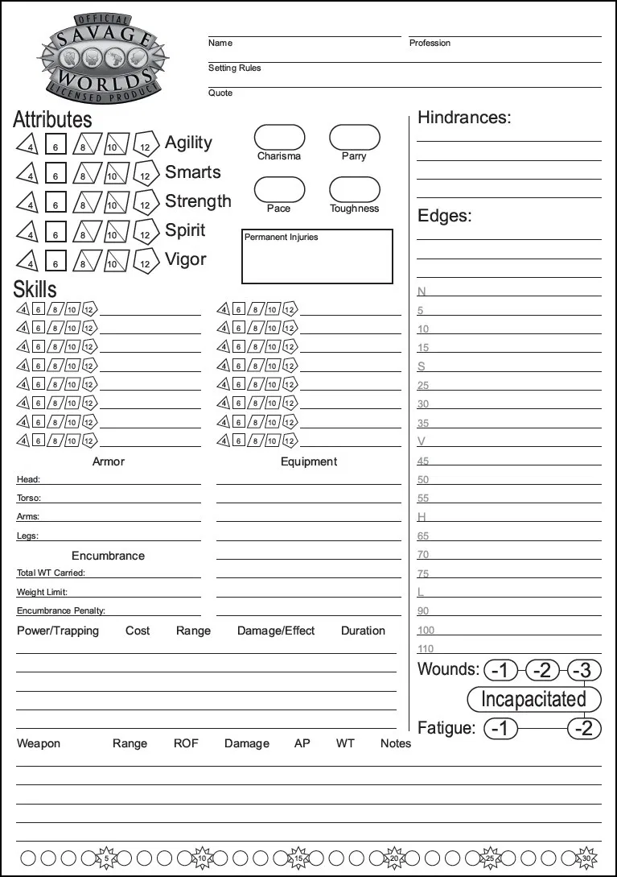
1
Biographical Information
Attributes
Skills
Armor, Equipment, and Powers
Hindrances and Edges.
2
5
3
4

Slide 8
Biographical Information
Name: What should someone call your character? It does not have to be their real name.
Profession: What does the character do on a day-to-day basis?
Setting Rules: What setting has your GM prescribed (e.g. Fantasy, Mystery, etc.)
Quote: Think of a quote that helps embody that character. It could be from a film, TV show, or book they like. It may also be an original quote they say or keep in mind at times to help guide them. Be creative.

Slide 9
2. Attributes
You have 5 Attributes: Agility, Smarts, Strength, Spirit, and Vigor.
Agility: speed, dexterity, balance, or finesse
Smarts: intelligence, learned knowledge, and critical thinking ability
Strength: physical prowess and muscle power
Spirit: personality, faith, and willpower
Vigor: health and constitution
Every character begins with a d4 in each attribute.
You have a total of 5 points you can spend to raise an attribute by one step (e.g. from d4 to d6).
Spend all 5 points raising your character’s attributes, and think about how their personality changes in accordance to those attributes. I.e. how is a character with a d10 in Smarts different from a character with a d4?

Slide 10
3. Skills
Consult page 4 in the Savage Worlds pdf for a list of possible skills.
You may discuss with your GM new skills that may be appropriate for the game you will be playing or for the character, e.g. an artist will likely want to have drawing, painting, or just art as a skill.
Each skill as a linked attribute that enhances the character’s proficiency with that skill, e.g. the Climbing skill is linked to Strength. This will be important when it comes to using that skill during play.
If you create your own skill, you must also decide what attribute that skill is linked to.
You have 15 points.
You do not begin with a d4 base in all skills.

Slide 11
3. Skills (cont.)
You may spend 1 point to raise a skill by one stage up to the level of its linked skill
E.g. If you have a d8 strength, it will cost 1 point to raise your Climbing skill to a d4, d6, and d8, or 3 points total.
You may spend 2 points to raise a skill by one stage beyond the level of its linked skill.
E.g. If you have a d8 strength, it will cost 2 points to raise your Climbing skill from a d8 to a d10.
Spend all of your skill points and think about how your character learned all of these skills. Ask yourself why they are so good at climbing and what can that mean for them in the course of the game.

Slide 12
4. Armor, Equipment, and Powers
Your GM will give you the information relevant to this section. You are free to brainstorm particular items you may want such as a lucky trinket, security blanket, or the clothing your character wears, but this is subject to GM approval.
Consult page 9 of the Savage Worlds pdf on eCampus for a list of possible items and work with your GM to establish of items your character possesses.

Slide 13
5. Hindrances and Edges
Hindrances are negative effects your character has that inhibit them in some capacity. They may be physical (i.e. a broken leg) or mental (i.e. easily angered).
Edges are positive effects your character has and are the complement to hindrances.
Consult pages 10-12 for a complete list of hindrances and edges.
The Charisma, Parry, Toughness, Pace, and Permanent Injuries fields will be filled in according to the Edges and Hindrances you have selected.
If you have no Edge or Hindrance that modifies your Pace, the base Pace for your character is 6 feet.

Slide 14
5. Hindrances and Edges (cont.)
There is no limit to the number of Edges and Hindrances you can assume but you must have a proportional number of each.
You may take 1 Minor Edge for each Hindrance your character has, or you may take 1 Major Edge for every 2 Hindrances your character has.
As with the Attributes and Skills, also think about the effect these Hindrances and Edges have your character and what that means for how you will play them.

Slide 15
You have now successfully created a PC! Continue to customize their personality, background, and other narrative aspects as you like and enjoy your game.

